Slide 1
USING A TWO-DIMENSIONAL BINARY MATRIX TO DETERMINE POSITION BY MARKING WITH A LIGHT POINT
AUTHORS: THEODORE ROLLAND (151250)
MASSEBO ROBEL (153922)
PROJECT SUPERVISOR: Dr hab. Inz . KONRAD URBANKSI
INSTITUTION: Poznan University of Technology

Slide 2
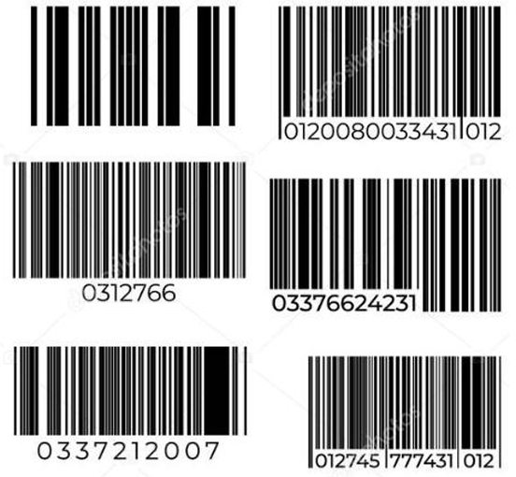
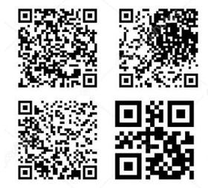
INTRODUCTION
The project draws inspiration from the efficiency and simplicity of barcode scanners by observing how such systems work in shops inspired the idea of creating a similar, accessible solution for position tracking
Key Insight:
Use a binary matrix and laser pointer for precise and cost-effective tracking.
Problem Statement:
Create an accessible, accurate position tracking system without expensive hardware.
Barcodes: They are one-dimensional, using parallel lines to store alphanumeric or numerical data, mainly for product identification.
QR (Quick Response) codes: store data in two dimensions, enabling greater capacity and flexibility for multimedia links, URLs, and text. They are used in mobile payments, ads, and more.

Slide 3
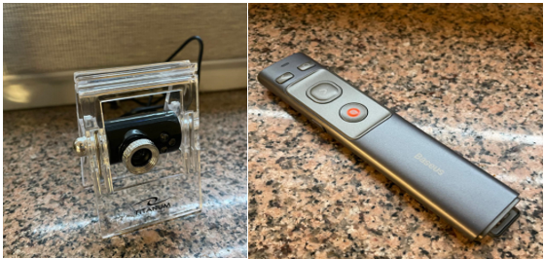
OBJECTIVES AND SCOPE
Primary Goal: Develop a real-time system to detect and track a laser pointer on a binary matrix.
Scope:
To develop a binary matrix to get an accurate position mapping.
Using OpenCV for real-time image processing which includes perspective correction and laser detection.
Extracting and visualizing the grid.
Testing the system in various diverse environmental conditions.
Hardware Configuration: Webcam, Laser Pointer.
Software Configuration: OpenCV, Python, NumPy, Matplotlib.

Slide 4
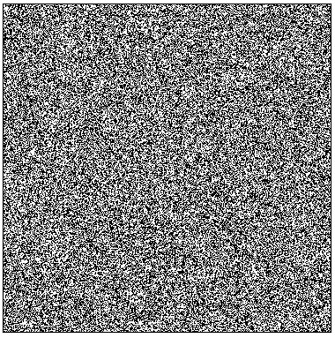
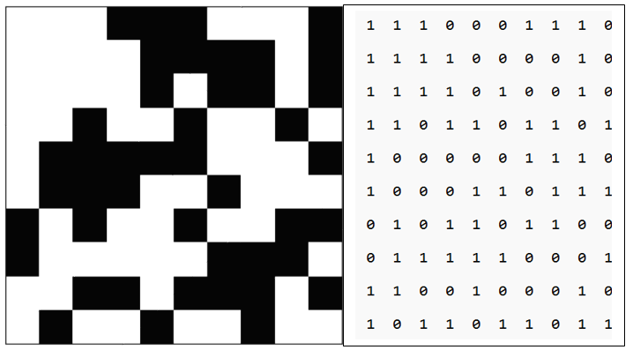
Binary Matrix Design
Structure:
10x10 for basic setups, expandable to high-resolution (e.g., 589x589).
Design Considerations:
Uniform cell size ensures precise laser detection.
Why a Binary Matrix?
High contrast, easy segmentation, and robust mapping.
Zero’s and one’s mapped accurately

Slide 5
CHALLENGES IN LASER-BASED DETECTION
Lighting Conditions
Environmental Noise
Matrix Alignment
Dot-to-Cell Calibration
Hand Movement Stabilization
Tracking the Laser Point
Detection of Black Cell as White Cell
Detection Difficulty in White-Only Regions

Slide 6


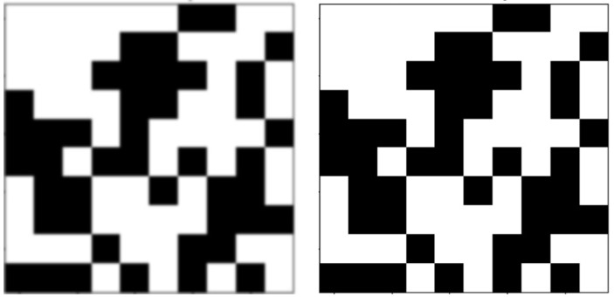


Noise Reduction Techniques
Morphological Operations: Techniques like opening (removing small objects) and closing (filling small holes) clean the image. Dilation sets a pixel to '1' if any under the kernel is '1', expanding white regions and enlarging foreground objects.
Original
Opening
Gaussian Blurring: A Gaussian blur cv2.GaussianBlur() is applied to reduce sharp noise, ensuring that only significant features, such as the laser dot, are detected.
Dilation
Closing

Slide 7
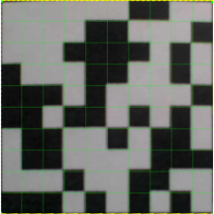
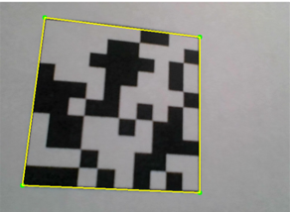
Perspective Correction
Challenge: Matrix distortion due to camera angle.
Solution:
Use OpenCV's cv2.getPerspectiveTransform() and cv2.warpPerspective().
Realign matrix for accurate tracking.
Outcome:
Perfectly rectified grid for reliable position mapping.

Slide 8
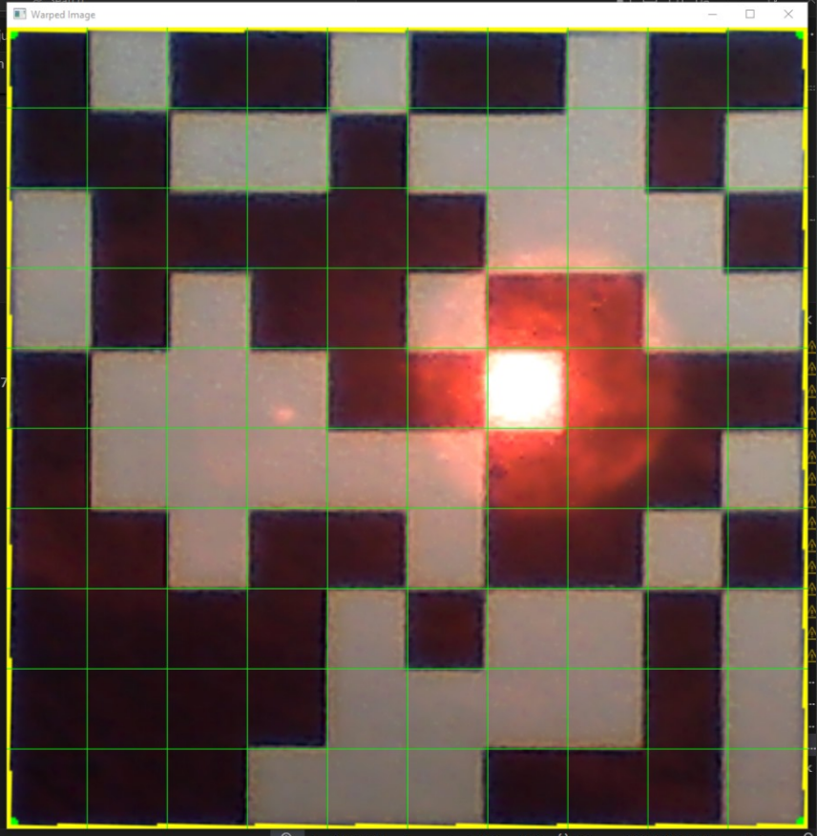
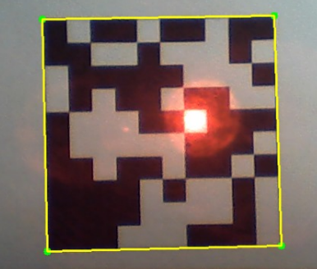
Laser Point Detection
The laser dot is isolated by filtering its specific color range
Colour Filtering:
Masking

Slide 9
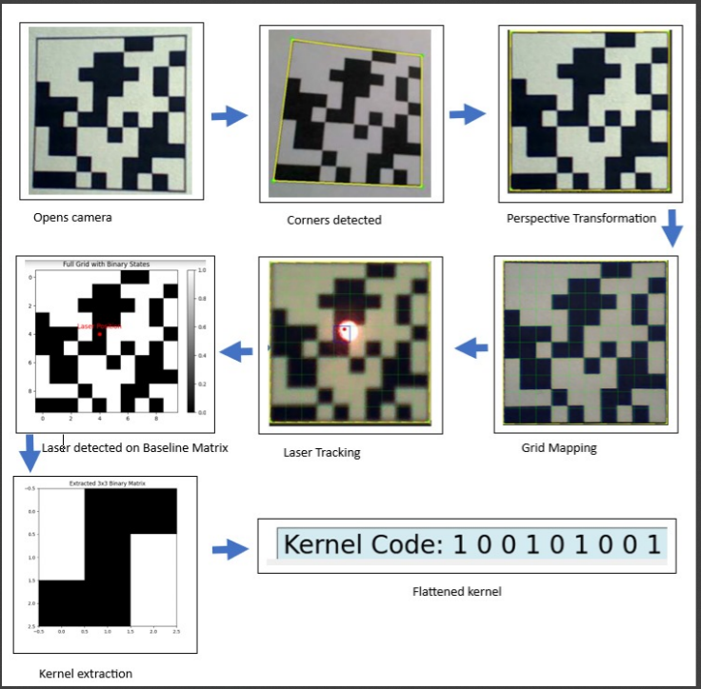
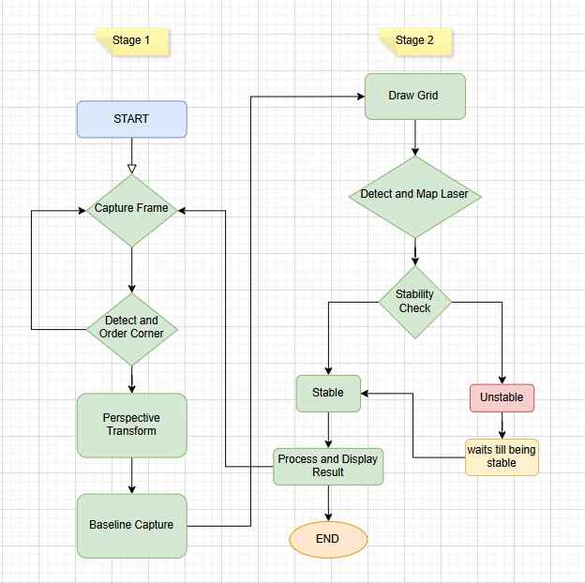
Algorithm Implementation
Stages followed till we extract the binary matrix kernel
Flow Chat of the Algorithm Implementation

Slide 10
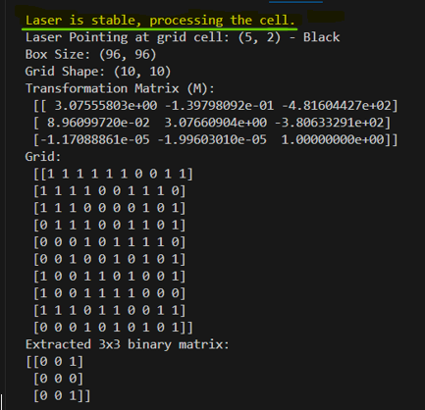
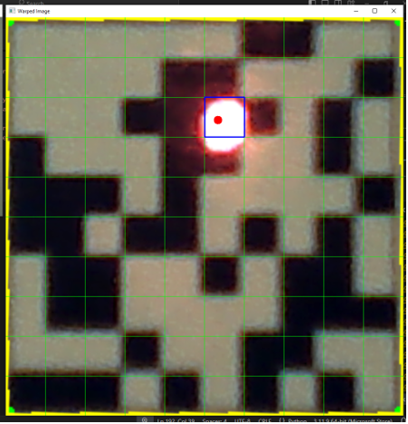
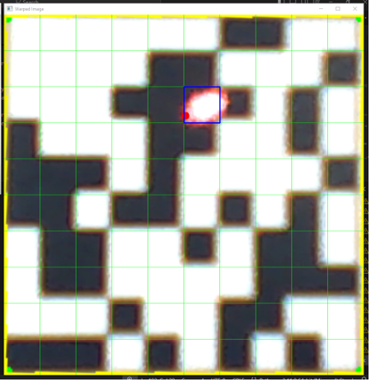
Analysis
stabilization Analysis: After a time wait of 0.5 seconds to ensure that the laser dot’s position was stable before processing the cell. The result were printed accurately
Environmental Variability (Lighting): These tests assessed the system's ability to maintain accuracy and efficiency despite external challenges.

Slide 11
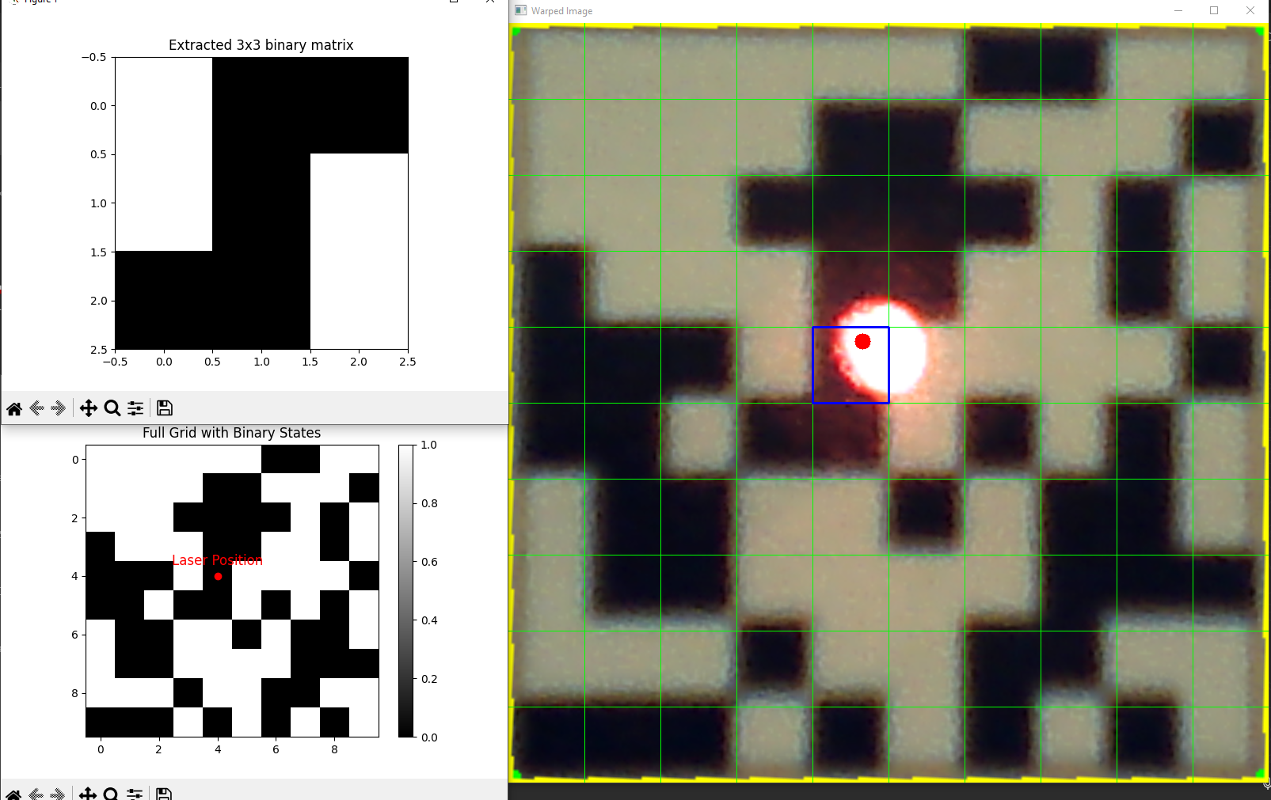
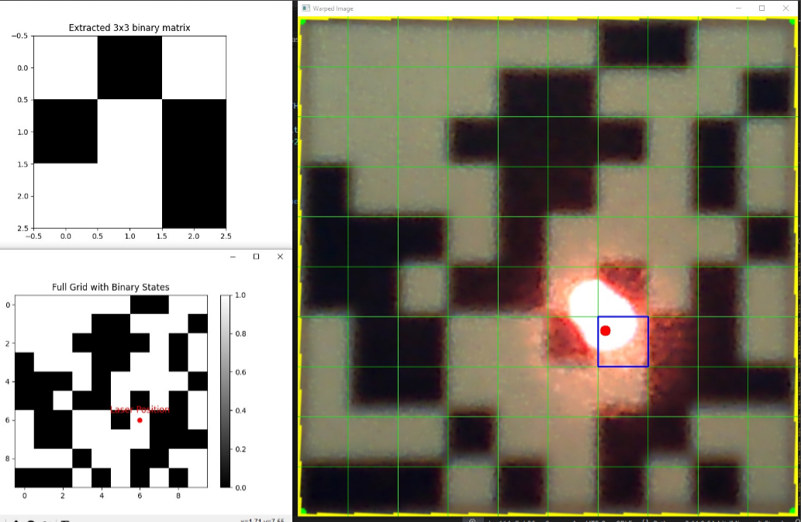
Analysis
Accuracy: The blue bounding box highlights the grid cell identified as the detected laser position. Despite laser dot being detected at the boundary of four adjacent grid cells, the system selects the cell where the majority of the laser dot area falls. This approach ensures that the chosen cell accurately represents the laser's dominant position, minimizing ambiguity in detection.

Slide 12
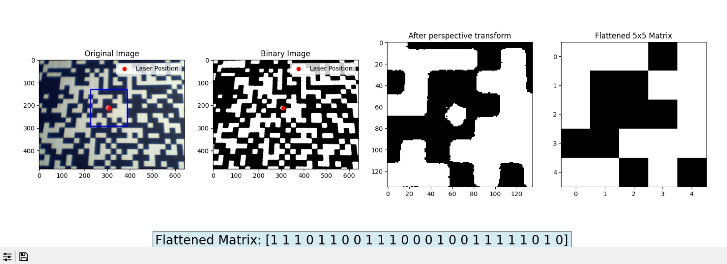

Impact of Distance on Accuracy
Camera Specifications:
Webcam Model: Titanium Onyx USB Camera (Model: TC 101)
Focal Length: 4.2 mm
Resolution: VGA (640 x 480 pixels)
Summary of Results
FOV = 46.4$°$
Distance of webcam for 27 cm × 27 cm Area: ≈ 32.1 cm.
When the distance exceeds 32.1 cm, the perspective transformation produces a 6×6 grid instead of the intended 5×5, causing errors in matrix flattening and making it difficult to extract a structured 5×5 binary matrix.

Slide 13
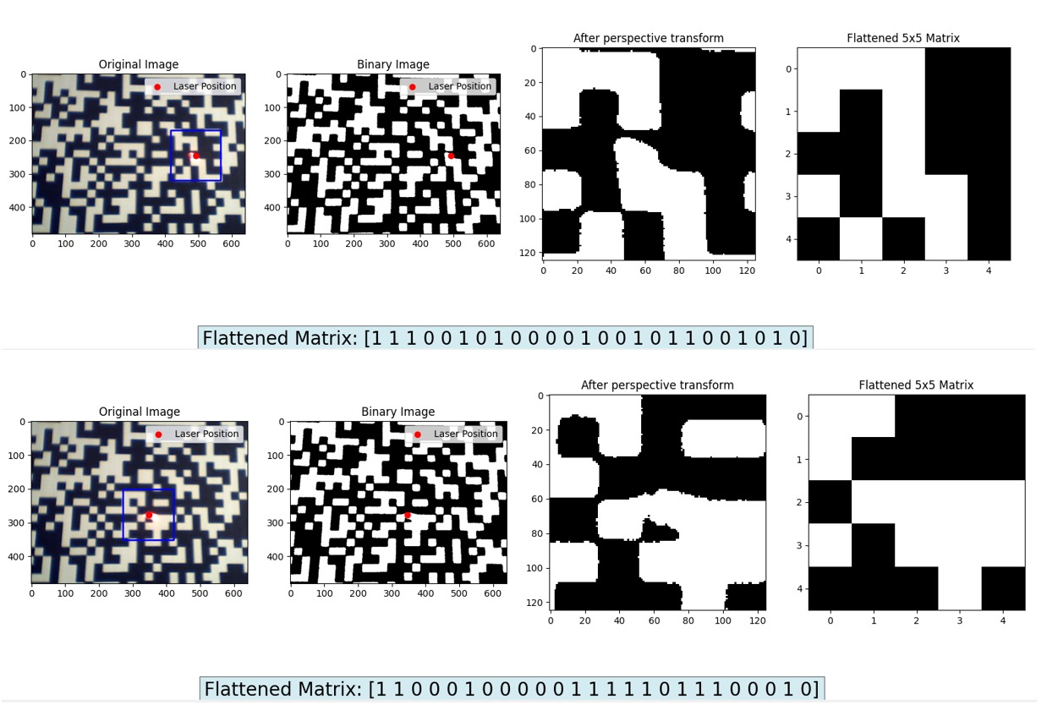
Effect Of Laser Intensity On Black Cells
High Laser Intensity Issue:
Excessive brightness made black appear white, causing detection errors. A stabilized snapshot, averaged from 30 frames, served as the reference (base image) for laser detection and matrix extraction.

Slide 14
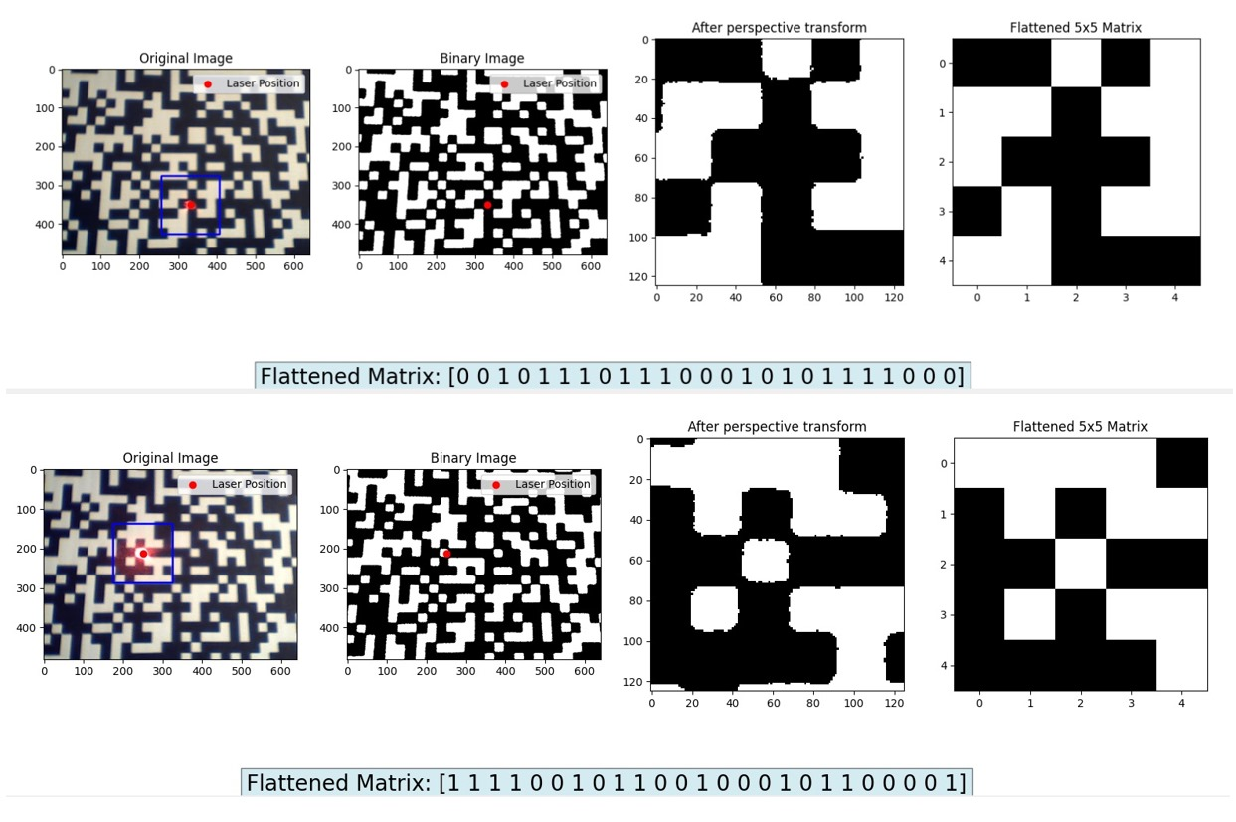
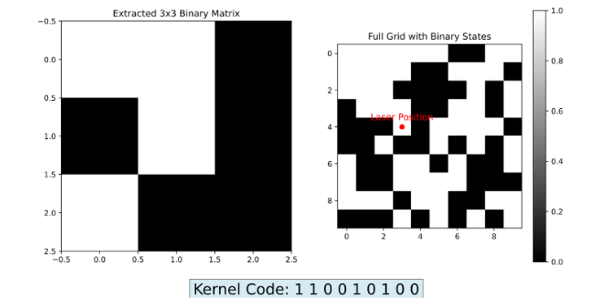
Results
Final Results obtained when implementing on the binary matrix.
https://www.youtube.com/watch?v=8X0mB1yMntU
https://www.youtube.com/watch?v=0okNEhtQrsg

Slide 15
Conclusion
Summary:
Developed a scalable, laser-based tracking system with improved accessibility.
Addressed key optical challenges, achieving:
Accurate laser-to-grid mapping under varying conditions.
Reliable detection and perspective alignment using OpenCV.
Stabilization for precise tracking despite hand movements.
Real-time performance at up to 45 FPS on standard hardware.
Future Work:
Integrate machine learning for advanced tracking.
Expand to gesture control applications.
Improve lighting adaptation and noise filtering.
Enable dynamic matrix detection and boundary handling.
Enhance integration with other systems.

Slide 16
References
Khurana, M., & Ahuja, R. (2019). Real-Time Object Detection and Tracking Using Laser Pointers. Journal of Computer Science and Engineering
Szeliski, R. (2021). Computer Vision: Algorithms and Applications (2nd ed.). Springer.
Bradski, G., & Kaehler, A. (2008). Learning OpenCV: Computer Vision with the OpenCV Library. O'Reilly Media.
Gonzalez, R. C., & Woods, R. E. (2018). Digital Image Processing (4th ed.). Pearson Education.
Shi, J., & Tomasi, C. (1994). Good Features to Track. Proceedings of the IEEE Conference on Computer Vision and Pattern Recognition (CVPR).
https://physics.stackexchange.com/questions/464866/determining-focal-length-of-converging-lens
https://opencv24-python-tutorials.readthedocs.io/_/downloads/en/stable/pdf/
https://docs.opencv.org/4.x/d9/df8/tutorial_root.html
https://www.vecteezy.com/vector-art/511079-barcode-scanner-stock-vector-illustration
https://pl.shein.com/Cat-Toy-Laser-Pointer-Pen,-Teaching-Presentation-Pointer-Pen-With-Red/purple/green-Laser-And-Infrared-Light-p-25822285-cat-4491.html
https://pl.dreamstime.com/kod-kreskowy-i-zestaw-kod%C3%B3w-qr-etykieta-na-pasku-skanowania-dla-przemys%C5%82u-lub-supermarket%C3%B3w-znak-kodu-kreskowego-wektorowego-image171982959
https://www.researchgate.net/figure/A-view-of-99-D-yy-and-D-xy-boxfilters_fig2_371911542

Slide 17
Thank You

